Slide 1
Revelation 2 : 12-17
Pergamum: No to compromise!

Slide 2
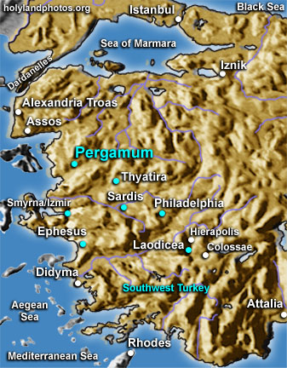
Revelation 2 : 12-17
Pergamum: No to compromise!

Slide 3
Revelation 2 : 12-17
Pergamum: No to compromise!
Context
Pergamum: The capital of the Roman province of Asia

Slide 4
Revelation 2 : 12-17
Pergamum: No to compromise!
Context
Pergamum: The capital of the Roman province of Asia
The seat of the Proconsul

Slide 5
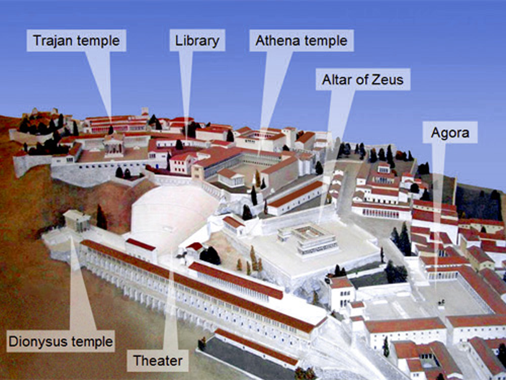
Revelation 2 : 12-17
Pergamum: No to compromise!
Context
Pergamum: The capital of the Roman province of Asia
The seat of the Proconsul
The Acropolis covered with imposing public buildings

Slide 6
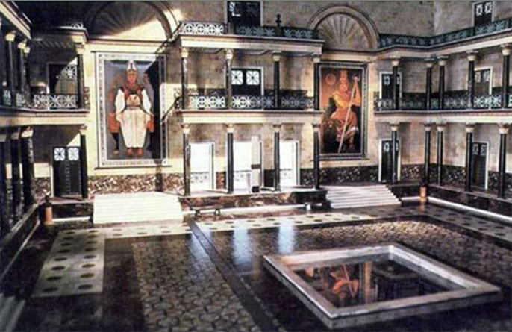
Revelation 2 : 12-17
Pergamum: No to compromise!
Context
Pergamum: The capital of the Roman province of Asia
The seat of the Proconsul
The Acropolis covered with imposing public buildings
The library (second only to that in Alexandria)

Slide 7
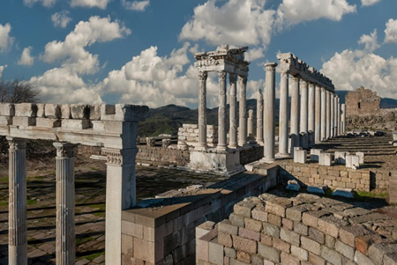
Revelation 2 : 12-17
Pergamum: No to compromise!
Context
Pergamum: The capital of the Roman province of Asia
The seat of the Proconsul
The Acropolis covered with imposing public buildings
The library (second only to that in Alexandria)
An important temple dedicated to the emperor Trajan

Slide 8
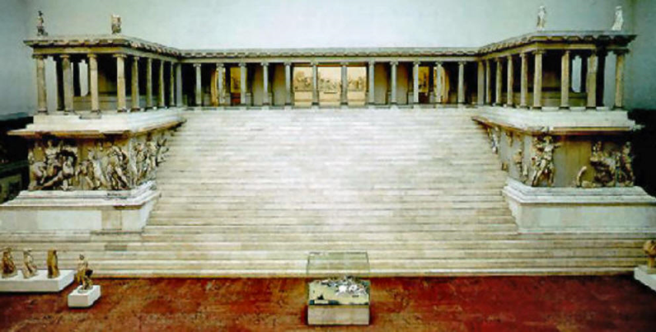
Revelation 2 : 12-17
Pergamum: No to compromise!
Context
Pergamum: The capital of the Roman province of Asia
The seat of the Proconsul
The Acropolis covered with imposing public buildings
The library (second only to that in Alexandria)
An important temple dedicated to the emperor Trajan
An enormous altar in honour of Zeus the saviour.

Slide 9
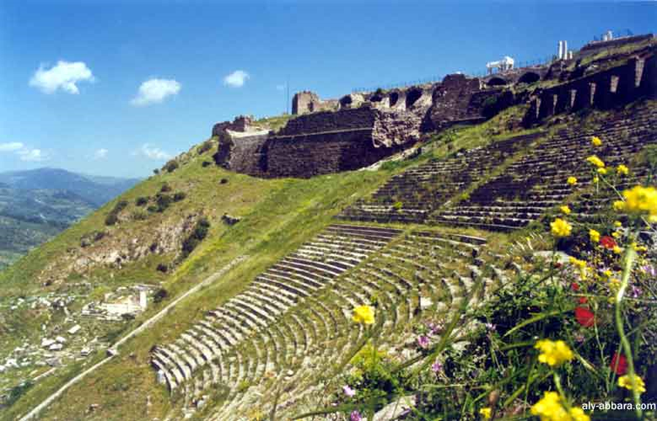
Revelation 2 : 12-17
Pergamum: No to compromise!
Context
Pergamum: The capital of the Roman province of Asia
The seat of the Proconsul
The Acropolis covered with imposing public buildings
The library (second only to that in Alexandria)
An important temple dedicated to the emperor Trajan
An enormous altar in honour of Zeus the saviour
An imposing theatre cut in the slope to Lower Pergamum

Slide 10
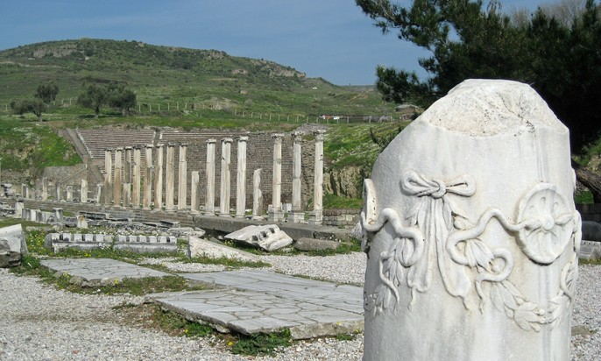
Revelation 2 : 12-17
Pergamum: No to compromise!
Context
Pergamum: The capital of the Roman province of Asia
The seat of the Proconsul
The Acropolis covered with imposing public buildings
The library (second only to that in Alexandria)
An important temple dedicated to the emperor Trajan
An enormous altar in honour of Zeus the saviour
An imposing theatre cut in the slope to Lower Pergamum
A medical centre dedicated to Asclepius: god of healing

Slide 11
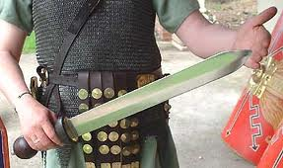
Revelation 2 : 12-17
Pergamum: No to compromise!
The description of the one who speaks v.12
“These are the words of him who has the sharp double- edged sword.”

Slide 12
Revelation 2 : 12-17
Pergamum: No to compromise!
The description of the one who speaks v.12
The Prophetic Message v.13-16
  “I know where you live – where Satan has his throne”

Slide 13
Revelation 2 : 12-17
Pergamum: No to compromise!
The description of the one who speaks v.12
The Prophetic Message v.13-16
  “I know where you live – where Satan has his throne”
  “Yet you remain true to my name – you did not renounce your faith in me, even in the days of Antipas, my faithful witness, who was put to death in your city – where Satan lives.”

Slide 14
Revelation 2 : 12-17
Pergamum: No to compromise!
The description of the one who speaks v.12
The Prophetic Message v.13-16
  “I know where you live – where Satan has his throne”
  “Yet you remain true to my name – you did not renounce your faith in me, even in the days of Antipas, my faithful witness, who was put to death in your city – where Satan lives.”
  The Reproach
  BUT, …you have people there who hold to the teachings of Balaam…likewise, you have people who hold to the teaching of the Nicolaitans.”

Slide 15

Revelation 2 : 12-17
Pergamum: No to compromise!
The description of the one who speaks v.12
The Prophetic Message v.13-16
  “I know where you live – where Satan has his throne”
  “Yet you remain true to my name – you did not renounce your faith in me, even in the days of Antipas, my faithful witness, who was put to death in your city – where Satan lives.”
  The Reproach
  BUT, …you have people there who hold to the teachings of Balaam…likewise, you have people who hold to the teaching of the Nicolaitans.”
“Have you allowed all the women to live?” he asked them. “They were the ones who followed Balaam’s advice and enticed the Israelites to be unfaithful to the Lord in the Peor incident, so that a plague struck the Lord’s people. Num. 31:15-16

Slide 16
Revelation 2 : 12-17
Pergamum: No to compromise!
The description of the one who speaks v.12
The Prophetic Message v.13-16
  “I know where you live – where Satan has his throne”
  “Yet you remain true to my name – you did not renounce your faith in me, even in the days of Antipas, my faithful witness, who was put to death in your city – where Satan lives.”
  The Reproach
  BUT, …you have people there who hold to the teachings of Balaam…likewise, you have people who hold to the teaching of the Nicolaitans.”
It seemed good to the Holy Spirit and to us not to burden you with anything beyond the following requirements: You are to abstain from food sacrificed to idols, from blood, from the meat of strangled animals and from sexual immorality. You will do well to avoid these things. Acts 15:28-29

Slide 17
Revelation 2 : 12-17
Pergamum: No to compromise!
The description of the one who speaks v.12
The Prophetic Message v.13-16
  “I know where you live – where Satan has his throne”
  “Yet you remain true to my name – you did not renounce your faith in me, even in the days of Antipas, my faithful witness, who was put to death in your city – where Satan lives.”
  The Reproach
  BUT, …you have people there who hold to the teachings of Balaam…likewise, you have people who hold to the teaching of the Nicolaitans.”
  The Warning – “Repent therefore! Otherwise I will soon come to you and will fight against them with the sword of my mouth.”

Slide 18
Revelation 2 : 12-17
Pergamum: No to compromise!
The description of the one who speaks v.12
The Prophetic Message v.13-16
The Exhortation v.17 - “He who has an ear, let him hear what the Spirit says to the churches. To him who overcomes, I will give some of the hidden manna. I will also give him a white stone with a new name written on it, known only to him who receives it.”

Slide 19
Revelation 2 : 12-17
Pergamum: No to compromise!
The description of the one who speaks v.12
The Prophetic Message v.13-16
The Exhortation v.17 -
    Hidden manna

Slide 20
Revelation 2 : 12-17
Pergamum: No to compromise!
The description of the one who speaks v.12
The Prophetic Message v.13-16
The Exhortation v.17 -
    Hidden manna
  A white stone

Slide 21
Revelation 2 : 12-17
Pergamum: No to compromise!
The description of the one who speaks v.12
The Prophetic Message v.13-16
The Exhortation v.17 -
    Hidden manna
  A white stone
  A new name

Slide 22
Revelation 2 : 12-17
Pergamum: No to compromise!
The description of the one who speaks v.12
The Prophetic Message v.13-16
The Exhortation v.17
A Call to the churches: “say ‘NO’ to compromise”

Slide 23
Revelation 2 : 12-17
Pergamum: No to compromise!
The description of the one who speaks v.12
The Prophetic Message v.13-16
The Exhortation v.17
A Call to the churches: “say ‘NO’ to compromise”
    Remember our identity

Slide 24
Revelation 2 : 12-17
Pergamum: No to compromise!
The description of the one who speaks v.12
The Prophetic Message v.13-16
The Exhortation v.17
A Call to the churches: “say ‘NO’ to compromise”
    Remember our identity
    Remember our destiny

Slide 25
Revelation 2 : 12-17
Pergamum: No to compromise!
The description of the one who speaks v.12
The Prophetic Message v.13-16
The Exhortation v.17
A Call to the churches: “say ‘NO’ to compromise”
    Remember our identity
    Remember our destiny
    5. A message for today!

